Slide 1
Steam - lite
Maxwell Light
&
Roger Lorelli

Slide 2





Problem domain?
What is the problem?
Today there exist numerous platforms to purchase digital rights to games
Why is this a problem?
This leads to disconnected libraries where a person might not remember what is in each library

Slide 3
Problem Domain cont.
What is your solution?
A centralized database that players can add games to which will consolidate their libraries.
Why is it a solution?
By doing this, players will be able to better see what games they currently own, have access to the installed executables, and be able to see what games their friends have, plus the marketplace from which they were purchased.

Slide 4
Application
Customer
A customer will be able to add games that exist within the database to a personal library.
Creation and management of customized game collections so that players can filter their library based on personal preference.
They will also be able to add other users of the system to a friends list, from which they can possibly see what other games their friends own and the marketplace from which it was purchased.

Slide 5

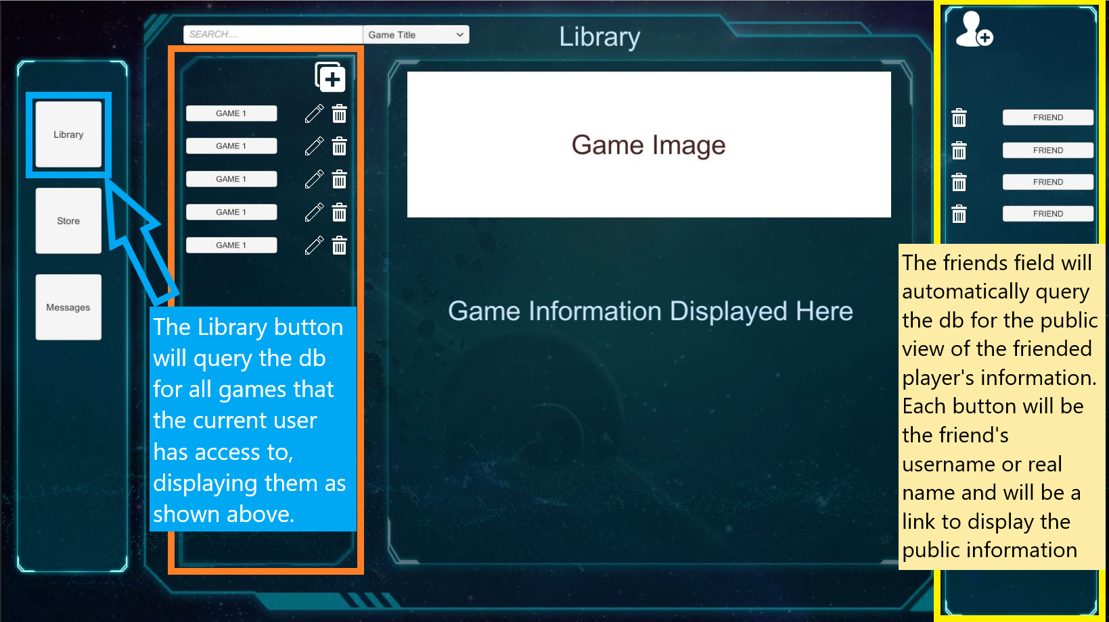
Application - Interaction
The main page will be split into 3 vertically divided sections with the left dedicated to the user’s game library, middle as a main display with a search bar at the top, and the right as a display for a friends list.
Each entry in the library, search results, and friends list will be a button that when clicked will display the information about the game/friend in the middle section.

Slide 6



Technology

Slide 7
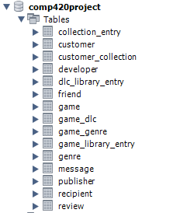
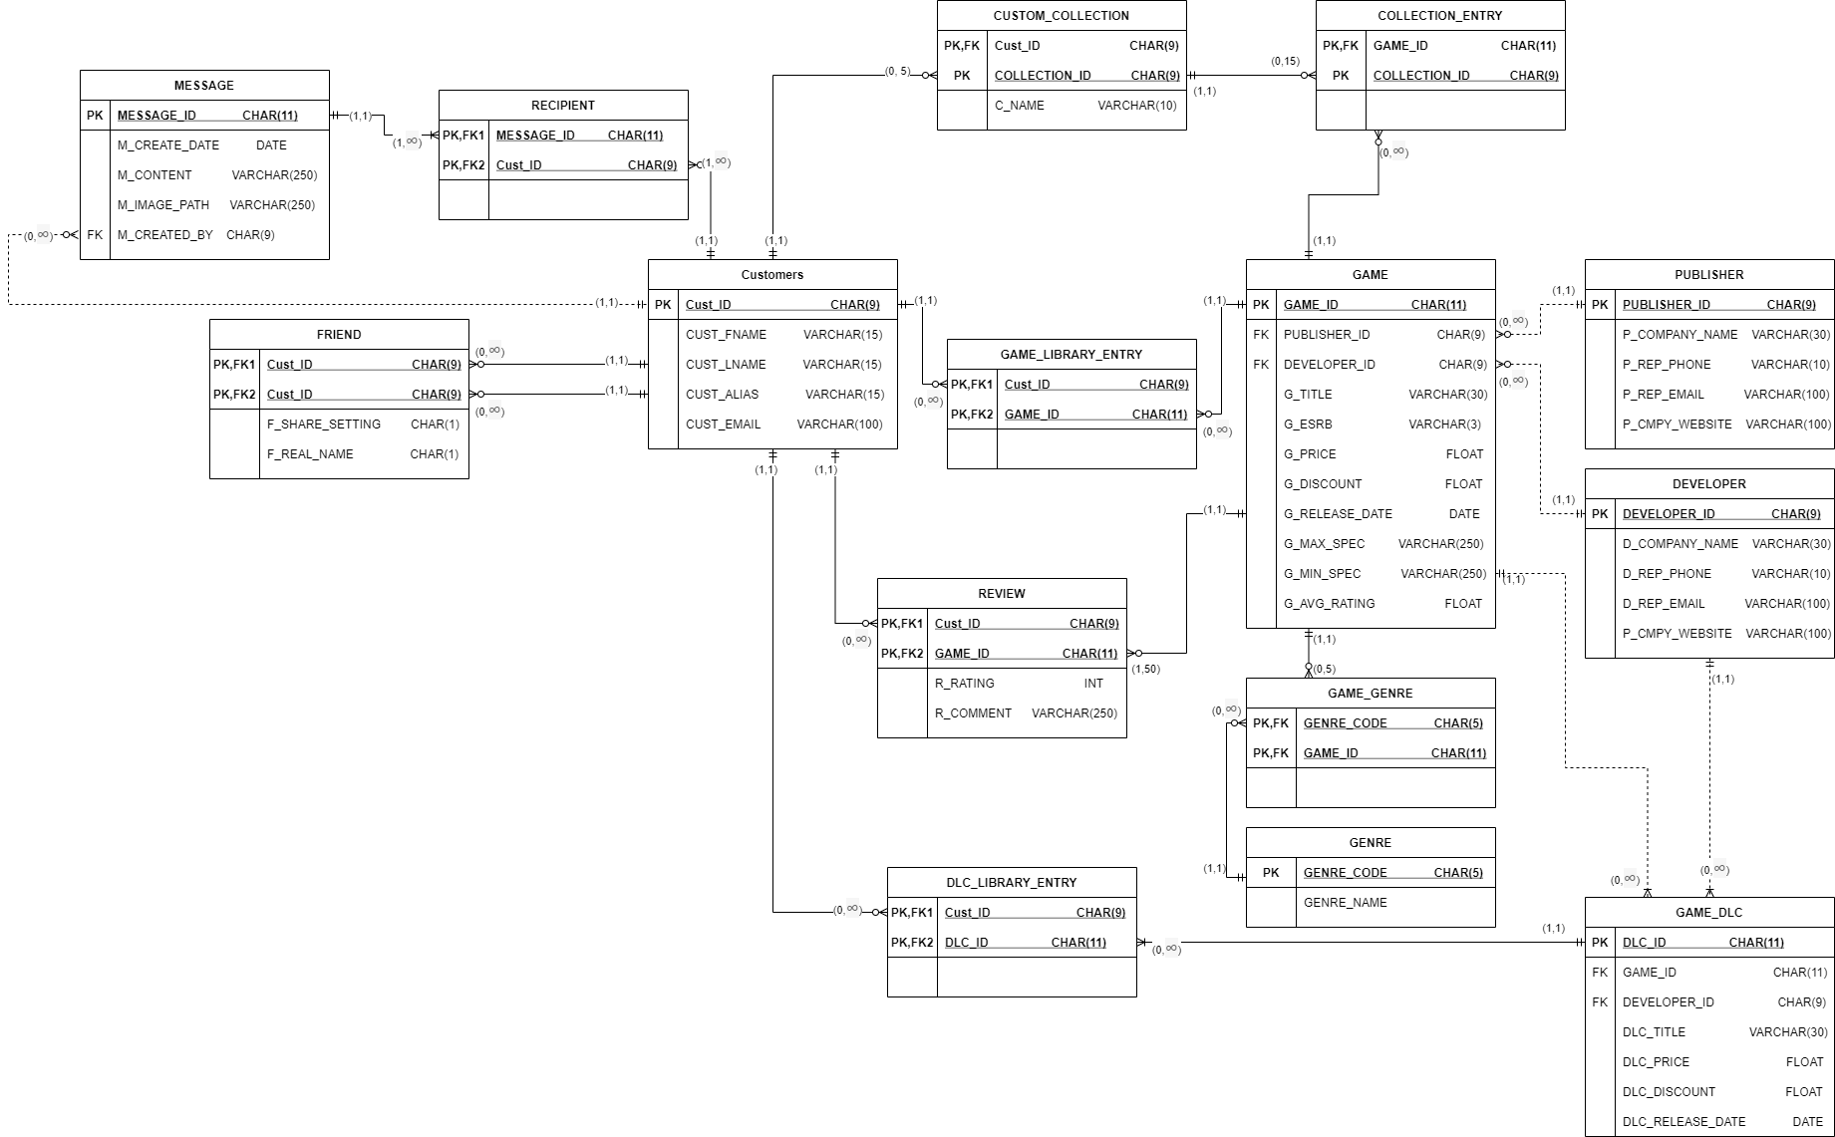
ERD/Schema

Slide 8
Views

Slide 9
Triggers - Queries

